Slide 1
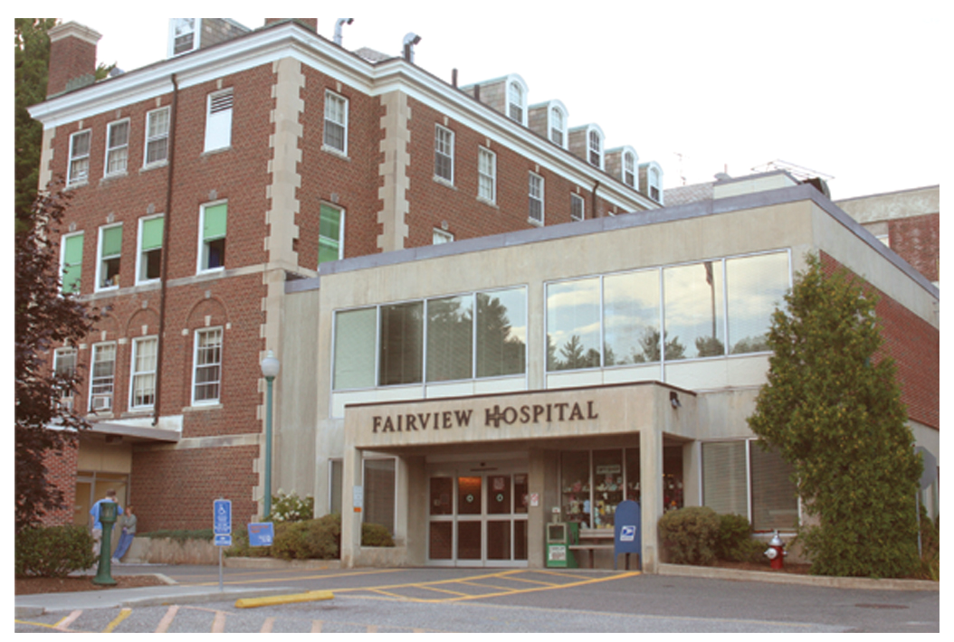
Fairview Hospital
Geraldine McQuoid
Director of Infection Prevention & Control
Lucinda Caruso
Performance Improvement Analyst

Slide 2
Our goals
Our major goal was to remedy the gaps between evidence based practice as presented in the first “UTI in the Elderly” conference and our current clinical practice
Engage an interdisciplinary staff in policy and practice issues

Slide 3
Policy changes
CAUTI prevention policy
  No longer collecting U/A, C/S upon foley catheter insertion
  No longer providing Vitamin C to catheterized patients
  “MD order exists” is no longer an acceptable indication for catheterization
Interdependent nursing action policy relating to urinary retention
  No longer collecting U/A, C/S upon catheter insertion
  No longer providing Vitamin C to catheterized patients

Slide 4
What we did
January- conference information shared at councils
February- nursing practice workgroup & journal club met to compare current policies to literature references provided at conference
March- consensus building (one-on-one with physician and nursing leaders)
April/May- policies were changed to reflect evidence based practice. Nursing staff meetings addressed upcoming changes & their rationale.
Now: Formal education is currently ongoing with nurses
Policy changes to be effective June 24th

Slide 5
What made an impact
Paradigm shift- we were practicing defensive medicine (establishing not present on admission status of UTI upon catheter insertion); this was done for the hospital, not the patient
This is less (unnecessary) work for staff; not a hard sell

